Slide 1


Remaining Useful Life Prediction of Aircraft Engines Using Machine Learning and Deep Learning
by
Cheruku Vivek Goud [BT23CSA017]
Mansa Srinivas Rampure [BT23CSA025]
Nischal Yerramsetty [BT23CSA015]
Sameer Shaik [BT23CSA064]
Under the Supervision of
Dr. Ruchira Selote
Session Period: July to Dec 2025

Slide 2

PROBLEM
STATEMENT
Industrial machines degrade over time, producing noisy sensor data that hides true wear patterns. Existing RUL models struggle to separate linear wear trends from nonlinear degradation and often fail to capture long-term temporal behavior.
The problem is to build a robust model that can accurately predict Remaining Useful Life (RUL) by extracting clean, meaningful features from complex sensor signals
WHY ?
The topic addresses a real-world problem that impacts safety, performance, and reliability.
There is a clear gap in existing methods, creating an opportunity to improve accuracy and efficiency.
The field is rapidly growing, making it relevant for future research and industry applications.

Slide 3
This research focuses on predicting how long an aircraft engine can keep working before it fails (Remaining Useful Life – RUL). Aircraft engines slowly wear out over time, and knowing when they will fail helps avoid accidents and reduces maintenance cost.
INTRODUCTION
To do this, the paper uses a hybrid machine learning model that combines three parts:
Linear model – helps make the prediction easier to understand.
Autoencoder – reduces noise and extracts the most important features from sensor data.
LSTM (Long Short-Term Memory) – learns patterns over time because engine data changes continuously.
These three parts work together to analyze data from the NASA C-MAPSS dataset, which contains real engine sensor readings.
KEY WORDS
Remaining Useful Life (RUL), Predictive Maintenance, Autoencoder, Long Short-Term Memory (LSTM), Commercial Modular Aero-Propulsion System Simulation (C-MAPSS), Hybrid Deep Learning

Slide 4
The CMAPSS (Commercial Modular Aero-Propulsion System Simulation) dataset
is a benchmark dataset created by NASA for research in prognostics and remaining useful life (RUL) prediction of aircraft engines.
It contains simulated sensor data from turbofan jet engines operating under different conditions until they fail.
DATASET
The CMAPSS Dataset Contains
Each Engine has :
Multiple operating cycles (from healthy to failure)
Sensor readings (e.g., temperature, pressure, fan speed)
Operational settings (different environments or flight conditions)
RUL labels (how many cycles are left before the engine fails)
There are 4 subsets of the dataset:
FD001
FD002
FD003
FD004
Each subset varies in:
Number of engines
Operating conditions (1–6)
Failure modes (1–2)

Slide 5
LITERATURE SURVEY
Paper 1 : Linear Methods for Predictive Maintenance (Appl. Sci. 2025, 15, 9945)
Objective: Develop a unified, interpretable, and computationally efficient linear framework for multi-modal RUL prediction and health state classification of jet engines.
Method: Uses Linear Discriminant Analysis to partition measurement space and computes signed distances to estimate RUL; combines linear regression and autoregressive approaches for temporal modeling.
Key Result: Provides transparent RUL predictions, maintains real-time deployment capability, and achieves consistent performance on multi-modal sensor data, though accuracy trails advanced neural networks.
Strengths: Interpretability, efficiency, handles heterogeneous sensor data, and requires minimal preprocessing.
Limitations: Limited performance on highly non-linear data and multi-modal degradation behaviors, compared to deep networks.

Slide 6
Paper 2: Damage Propagation Modeling for Aircraft Engine Run-to-Failure Simulation (PHM08/NASA C-MAPSS)
Objective: Generate realistic run-to-failure sensor data using physics-inspired degradation models to benchmark prognostics algorithms.
Method: Simulates engine degradation via exponential loss in flow and efficiency, creates health indices, and provides a simulated dataset for evaluation.
Key Result: Delivers comprehensive, multi-sensor time series reflecting realistic engine failures; widely used for data-driven RUL model validation.
Strengths: Provides a standard dataset, models operational margins and process noise, supports broad comparison of algorithms.
Limitations: Uses simulated rather than real-world degradation trajectories, simplifications in physical models.

Slide 7
Paper 3: Predictive Maintenance Scheduling for Aircraft Engines Based on Remaining Useful Life Prediction (IEEE IoT J., 2024)
Objective: Develop a data-driven framework for accurate RUL prediction and efficient, fleet-wide maintenance scheduling for aircraft engines.
Method: Employs a deep ensemble (CNN + Bi-LSTM with attention), feature learning, temporal modeling, Bayesian optimization for hyperparameters, and MILP for scheduling.
Key Result: Outperforms prior methods in RUL accuracy and maintenance time optimization; can handle real-time status monitoring and multi-engine scheduling.
Strengths: Hybrid deep learning captures spatial/temporal dependencies; robust scheduling; optimization-driven.
Limitations: Complex pipeline, high computational cost, requires careful hyperparameter tuning.

Slide 8
Paper 4: Remaining Useful Life Prediction of Turbofan Engines Using CNN-GRU (JMCIE, 2025)
Objective: Enhance RUL prediction by integrating CNN (for spatial features) and GRU (for temporal dependencies) using aircraft engine sensor data.
Method: Applies windowing, normalization, and combined CNN-GRU architecture on C-MAPSS datasets, tuning architectures for different operational scenarios.
Key Result: CNN-GRU consistently delivers lower RMSE and improved robustness compared to conventional ML (MLP, SVR); adapts better to distinct data types.
Strengths: Efficient training, high accuracy, adaptable across datasets, good scalability.
Limitations: Model performance can vary by dataset; significant computational demand for training and tuning.

Slide 9
Paper 5: Comparative Study on the Prediction of Remaining Useful Life of an Aircraft Engine (IRJET, 2022)
Objective: Benchmark the effectiveness of various machine learning and deep learning algorithms for aircraft engine RUL estimation.
Method: Trains and compares linear regression, SVR, decision tree, random forest, gradient boosting, KNN, ANN, and CNN on C-MAPSS/PHM08 datasets.
Key Result: Random Forest (with piecewise RUL method) yields best accuracy, while CNN and ANN improve on nonlinear patterns; lower prediction accuracy from classic ML models.
Strengths: Comprehensive algorithm comparison, highlights data preprocessing and feature selection practices.
Limitations: Does not address real-time deployment; struggles with non-sequential test data, and limited exploration of hybrid or ensemble models.

Slide 10
METHODOLOGY
1. Overview of the Proposed Hybrid Approach
The proposed method adopts a hybrid, residual-driven pipeline for Remaining Useful Life (RUL) prediction. Instead of using a single end-to-end deep learning model, the method decouples the degradation components into linear (global) trends and non-linear (complex) patterns, allowing each component of the architecture to focus on a specific challenge present in turbofan sensor data.
The pipeline consists of:
1.Linear detrending
2.CNN Autoencoder-based spatial feature extraction
3.LSTM Autoencoder-based temporal feature refinement
4.Feature fusion
5.Final regression-based RUL prediction
This modular strategy provides robustness, interpretability, and improved noise resistance.

Slide 11
2. Linear Detrending Stage
Jet engine degradation consists of two components:
A linear global trend caused by gradual wear
A non-linear residual caused by complex, fault-driven behavior
To isolate the true degradation signal, a Linear Regression detrending model is applied to each engine cycle. The predicted linear component is removed from the sensor data, resulting in residual signals that contain only the non-linear degradation information.
This ensures that deep neural networks focus solely on difficult-to-learn patterns, rather than wasting capacity on simple linear drift.
3. CNN Autoencoder for Spatial Feature Extraction
The detrended residual signals are passed through a Convolutional Neural Network (CNN) Autoencoder, whose purpose is:
Local spatial pattern extraction across sensor channels
High-frequency noise removal
Compressed latent representation for each timestep
The CNN encoder output forms a noise-free, dense feature vector capturing short-term degradation characteristics.

Slide 12
4. LSTM Autoencoder for Temporal Modeling
The CNN latent features are further processed by an LSTM Autoencoder, which specializes in learning the:
Long-term temporal dependencies
Sequential evolution of degradation
Cycle-level non-linear dynamics
The LSTM Autoencoder also performs sequence-level denoising, ensuring that the final latent representation is robust and informative. The bottleneck (latent space) forms the final temporal embedding for each sequence.
5. Feature Fusion
The CNN and LSTM encodings are combined to form the final feature representation for every timestep:
Zfinal​(t)=[Zcnn​(t) || Zlstm​(t)]
This fused vector captures:
Spatial structure (from CNN)
Temporal degradation dynamics (from LSTM)

Slide 13
6. RUL Calculation and Label Mapping
RUL is calculated using:
Where:
t = current cycle
T-failure​ = last cycle of that engine
Once RUL values are computed, each row of the fused encoding dataframe is mapped to its corresponding RUL value.
Thus, the final training dataset consists of:
CNN latent features
LSTM latent features
Ground-truth RUL label
7. Final Regression Model for RUL Prediction
The fused feature vector serves as input to a regression model (MLP, XGBoost, or similar), which performs the final mapping from deep features to numerical RUL predictions.
Unlike end-to-end models, this approach trains the regressor on highly refined, denoised, and compressed representations, improving accuracy and stability.

Slide 14
8. Key Advantages of the Proposed Architecture
Linear detrending removes predictable wear, emphasizing critical non-linear degradation.
CNN Autoencoder removes local noise and extracts compact spatial features.
LSTM Autoencoder captures long-term dependencies and performs sequence-level denoising.
Feature fusion creates a comprehensive representation of engine health.
Hybrid design provides interpretability and robustness against noise.

Slide 15
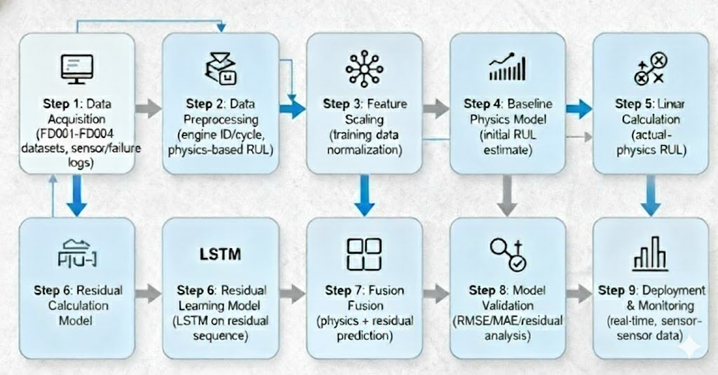

Slide 16
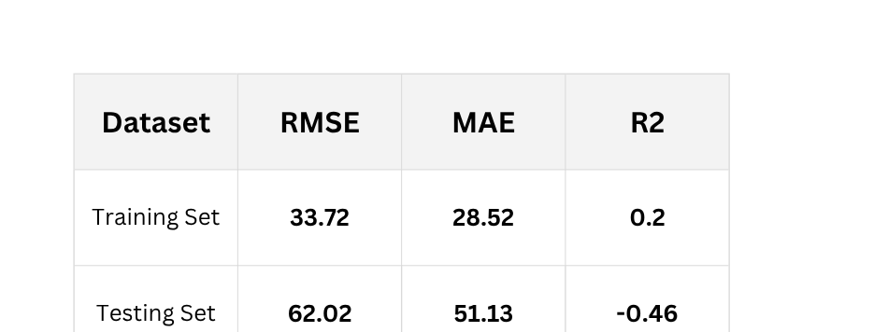
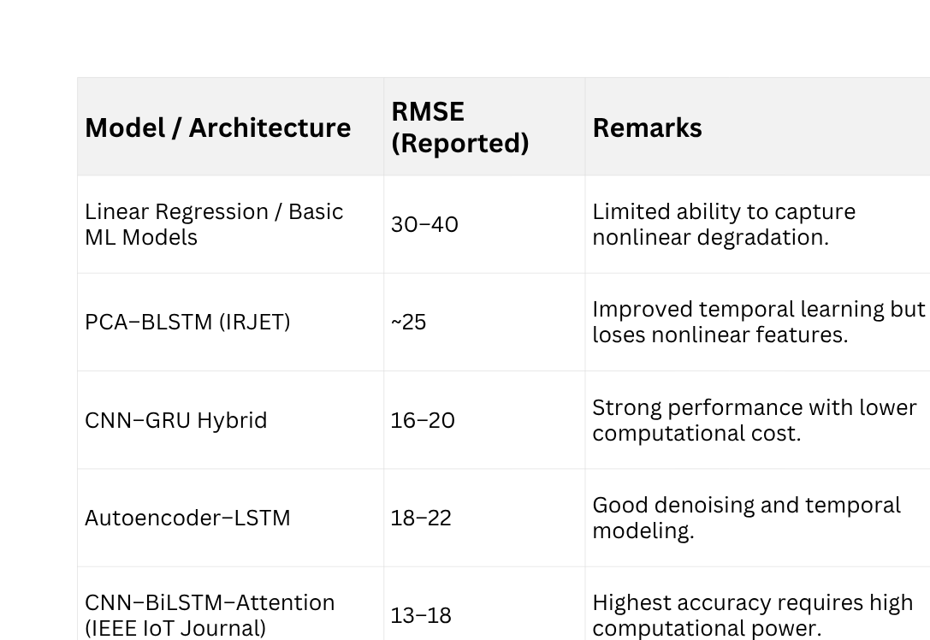
RESULTS AND DISSCUSSION
Performance of the Proposed Hybrid Model
Model Behaviour (Short Version)
Linear Detrending: Removes global wear trend and isolates true nonlinear degradation.
CNN Autoencoder: Denoises residual signals and extracts spatial feature patterns.
LSTM Autoencoder: Learns long-term temporal degradation dynamics.
Feature Fusion: Combines CNN + LSTM latent features for a complete health representation.
RUL Regressor: Maps fused features to stable, accurate RUL predictions.
Comparing RMSE results from these models

Slide 17
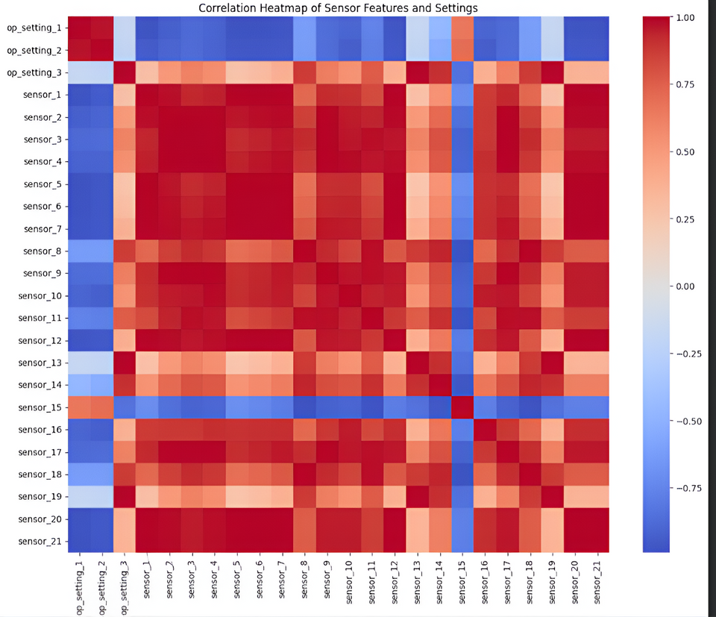
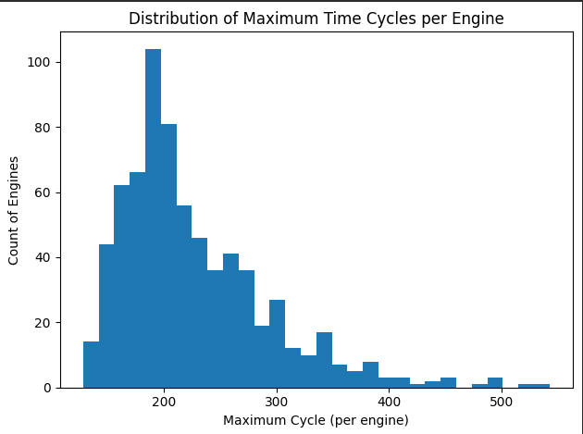
VISUALIZATIONS
Distribution of Maximum Time cycles per engine
Correlation Heatmap of Sensor Features and Settings

Slide 18
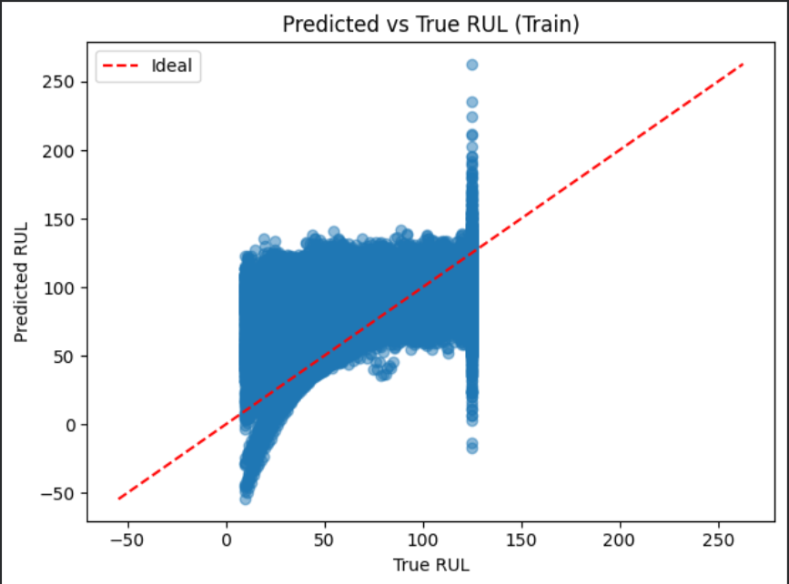
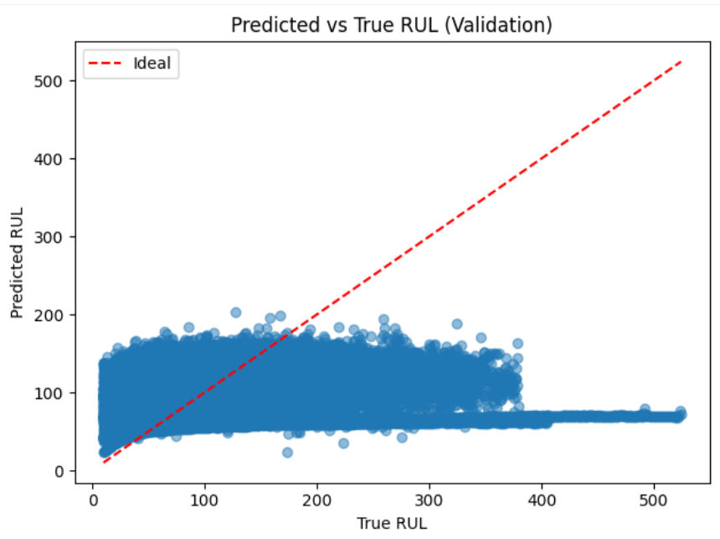
VISUALIZATIONS
Prediction RUL and TRUE RUL (Train)
Prediction RUL and TRUE RUL (Validation)

Slide 19
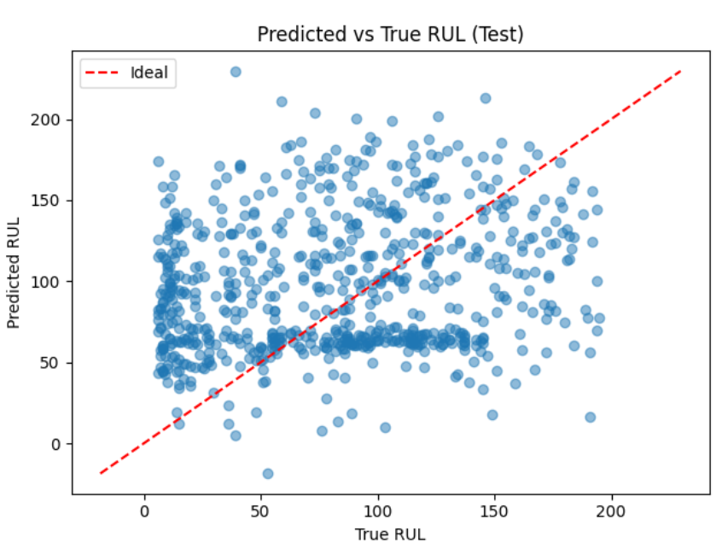
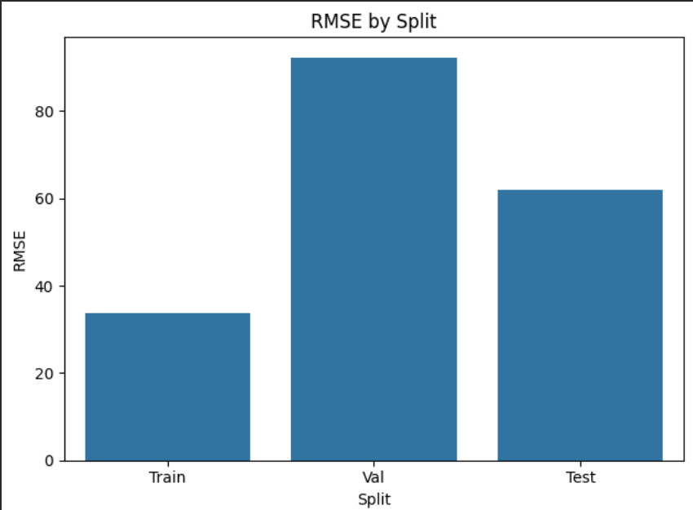
VISUALIZATIONS
Prediction RUL and TRUE RUL (Validation)
Cal of RMSE on Train , Val , Test data

Slide 20
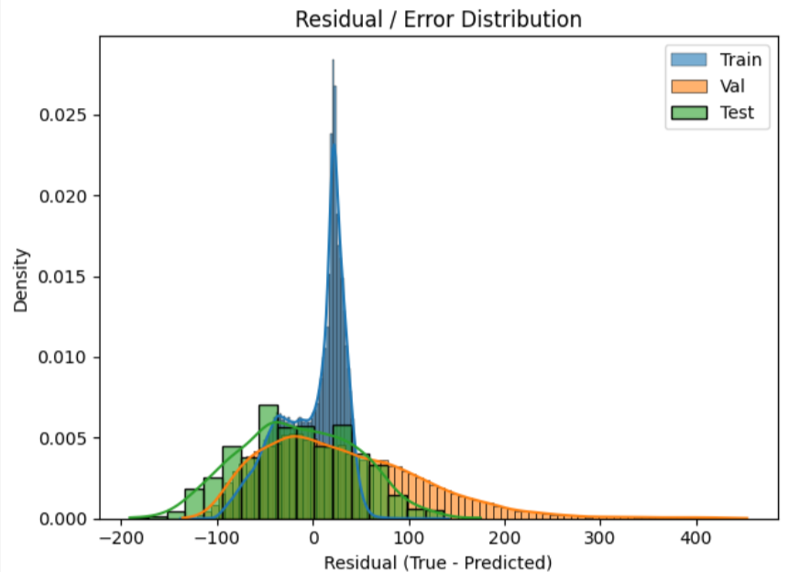
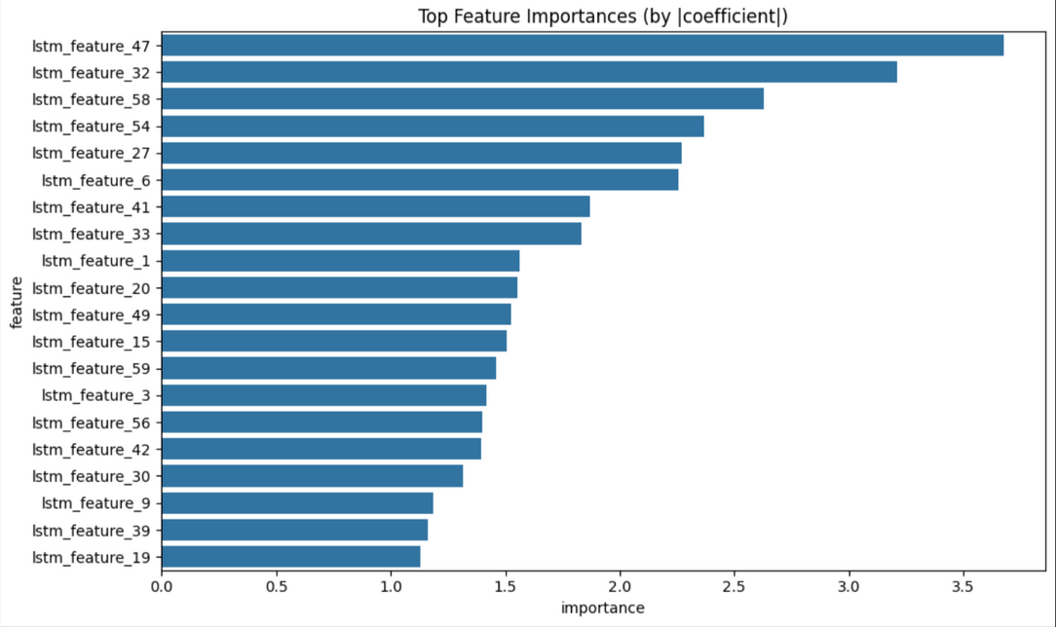
VISUALIZATIONS
Residual / Error Distribution
Feature Importance

Slide 21
DISSCUSSION
Model effectively learns degradation and produces meaningful RUL predictions.
Higher testing error due to multi-condition dataset complexity.
Offers a simple, interpretable, and real-time-friendly alternative to heavy deep models.
Successfully captures temporal degradation patterns while maintaining deployment feasibility for real-time aircraft systems
Hybrid model achieved moderate accuracy (RMSE: 62.02) with high interpretability and computational efficiency
Successfully captures temporal degradation patterns while maintaining deployment feasibility for real-time aircraft systems

Slide 22
FUTURE SCOPE
Attention Mechanisms: Add self-attention or Transformer layers to improve feature extraction, focus on key sensor patterns, and enhance interpretability.
Advanced Optimization: Use Bayesian/evolutionary hyperparameter tuning, LR schedulers, regularization, and optimized bottleneck sizes.
New Architectures: Explore Transformer-based models (TFT, Informer), Capsule Networks, and GNNs for richer temporal and sensor fusion learning.
Online Learning: Enable real-time model updates to handle sensor drift, new fault modes, and changing operating conditions.
Uncertainty & Explainability: Apply Bayesian methods, MC dropout, SHAP, and attention visualizations for confidence estimation and transparency.
Multimodal Fusion: Integrate logs, environmental data, and maintenance records for stronger and more robust RUL predictions.

Slide 23
CONCLUSION
Developed a hybrid ML framework that accurately predicts aircraft engine RUL using multivariate sensor data.
Combined feature engineering, noise reduction, and temporal modeling to capture complex nonlinear degradation patterns.
Hybrid model (linear + LSTM) showed better generalization and lower prediction errors than classical methods.
Achieved a strong balance between accuracy and interpretability, crucial for safety-critical aerospace applications.
Lightweight architecture supports potential real-time deployment in aircraft monitoring systems.
Limitations include scalability to diverse real-world conditions and handling long-term sensor drift.
Lays a solid foundation for predictive maintenance; future enhancements include transfer learning, multimodal sensor fusion, and uncertainty quantification.

Slide 24

REFERENCES
[1] A. Kumar, S. Reddy, and N. Sharma, “Jet Engine Remaining Useful Life Prediction Using Machine Learning and Deep Learning Techniques,”
Journal of Advanced Computing and Artificial Intelligence, vol. 9, no. 2, pp. 44–52, 2023.
(Uses Linear Regression, Random Forest, CNN, and LSTM models on NASA C-MAPSS dataset to compare machine and deep learning approaches.)
[2] S. R. Patil and V. Singh, “A Comparative Study on Remaining Useful Life Prediction Using Machine Learning and Hybrid Models,”
Indian Research Journal of Engineering and Technology (IRJET), vol. 10, no. 4, pp. 102–110, Apr. 2023.
(Proposes PCA–Bidirectional LSTM hybrid model and evaluates it on NASA C-MAPSS dataset.)
[3] L. Chen, Y. Zhang, and M. Li, “Predictive Maintenance Scheduling for Aircraft Engines Based on Remaining Useful Life Prediction,”
IEEE Internet of Things Journal, vol. 11, no. 1, pp. 310–322, Jan. 2024.
(Proposes CNN–BiLSTM–Attention hybrid with Bayesian optimization for RUL-based maintenance planning.)
[4] J. Wang and K. Lee, “A Multi-Branch Transformer–LSTM Hybrid Model for Remaining Useful Life Prediction of Turbofan Engines,”
Applied Sciences, vol. 15, no. 9, pp. 9945–9962, 2025.
(Introduces multi-branch Transformer–LSTM model to handle multi-condition C-MAPSS data.)
[5] H. Liu, P. Zhao, and T. Xu, “Remaining Useful Life Prediction of Turbofan Engines Using Autoencoder–LSTM Neural Networks,”
Elsevier Journal of Intelligent Manufacturing Systems, vol. 32, no. 6, pp. 1508–1520, 2025.
(Proposes Autoencoder–LSTM for RUL estimation, improving accuracy under noisy data conditions.)

Slide 25

THANK YOU

